Slide 1
IMAGE PROCESSING

Slide 2
Why process an image ?
Same image but different sizes
Different quality based on user bandwidth
Object/Facial recognition
Robotics
Forensics

Slide 3
Same image but different sizes
Image thumbnails, chat icon, profile icon, product preview image and HD version
Video Thumbnails,
Set the quality of image based on user bandwidth

Slide 4
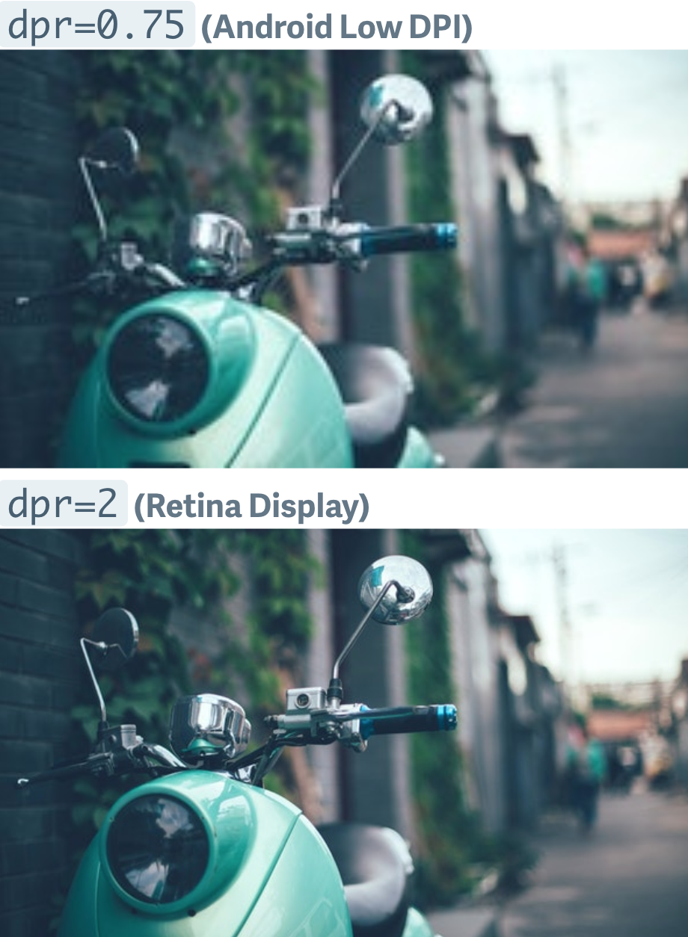
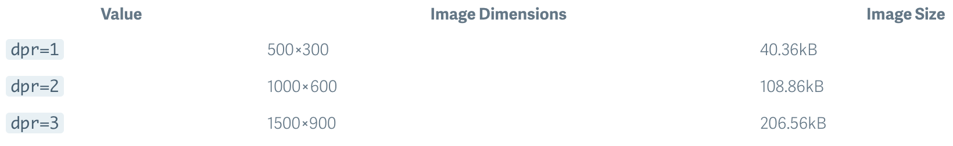
Different quality based on user bandwidth
WebP is an emerging image format designed by Google. No loss in quality, less size, faster website.
Dynamically choose quality to server based on bandwidth

Slide 5
Object/Facial recognition
Blur sensitive/Objectionable content
Blur faces, houses, car number plates etc. to protect privacy
Identify celebrities, social contacts
Interactive Marketing and Creative Campaigns

Slide 6
Robotics
reCAPTCHA helps build datasets that can help in AI powered vehicles
Robots use image processing to detect speed, terrain and becoming aware of surroundings

Slide 7
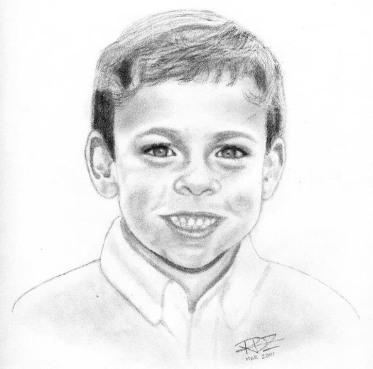
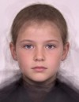
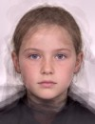






Forensics & Criminal investigation
Find people based on sketch by sketch artists
Fingerprint enhancement
3D reconstruction of crime scene
Age progression

Slide 8
AWS rekognition demo
AWS Rekognition , API Reference

Slide 9
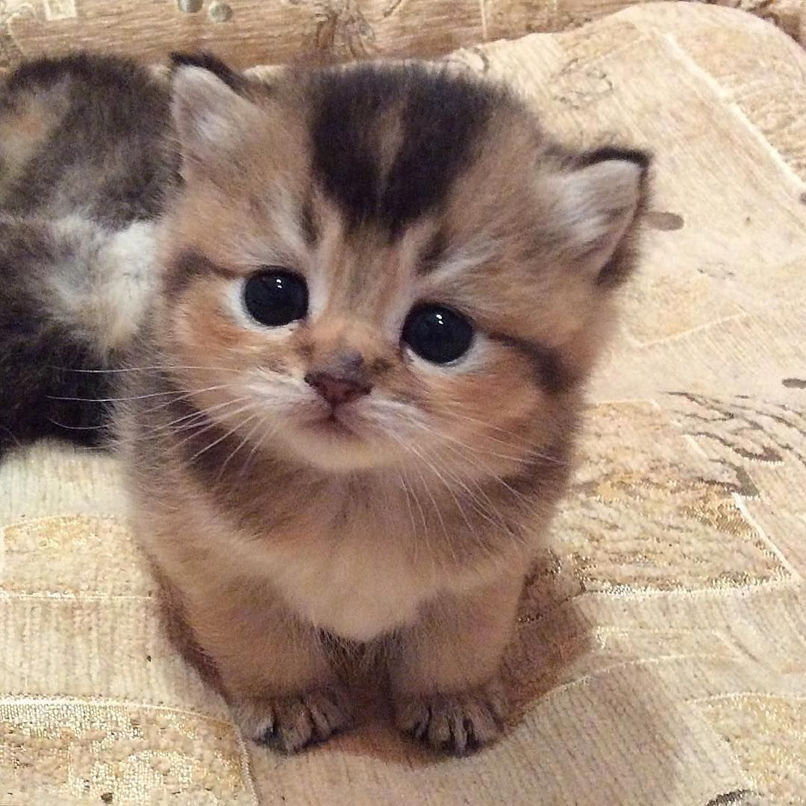
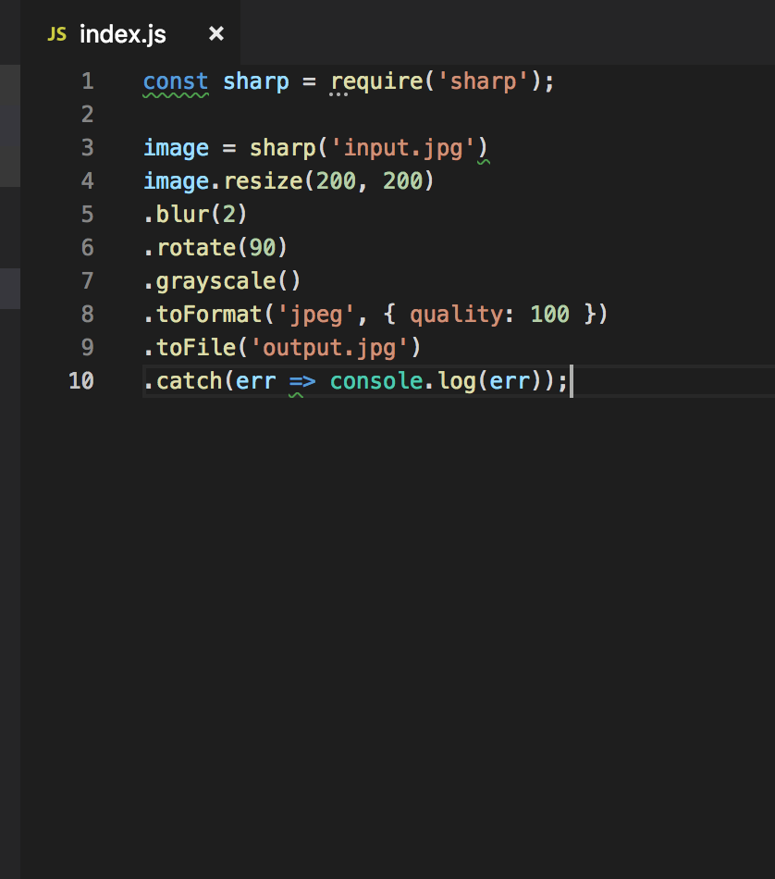

Node Sharp
Sharp API

Slide 10
Thanks
Sample Code Available at - https://github.com/ktajpuri/aws-node-rekognition

